Slide 1
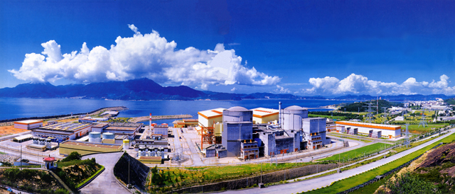
Recent results from Daya Bay
Wenqiang Gu
Shanghai Jiao Tong University
On behalf of the Daya Bay Collaboration

Slide 2
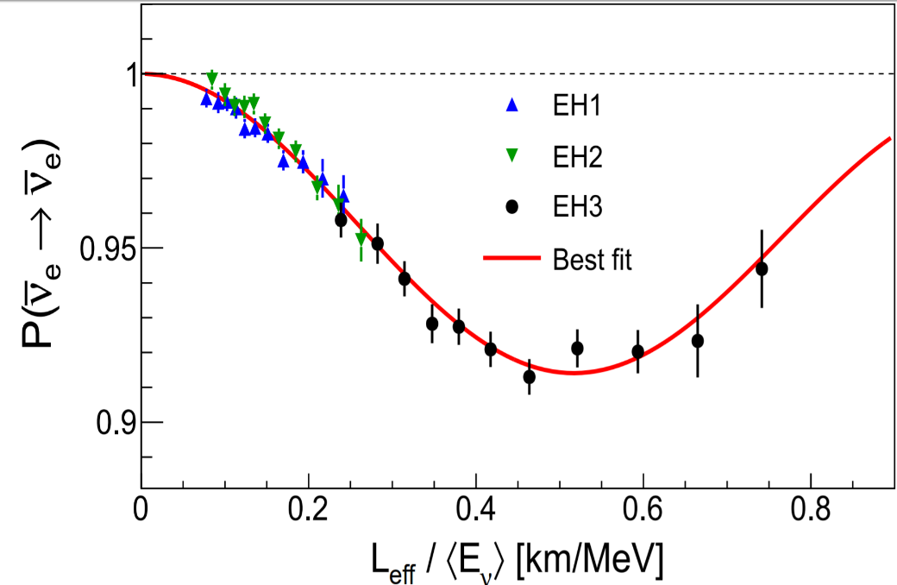
Outline
Daya Bay
Latest Results
Oscillation measurement
Sterile neutrino search
Flux & spectrum measurement of antineutrino
Fuel evolution analysis
Summary

Slide 3
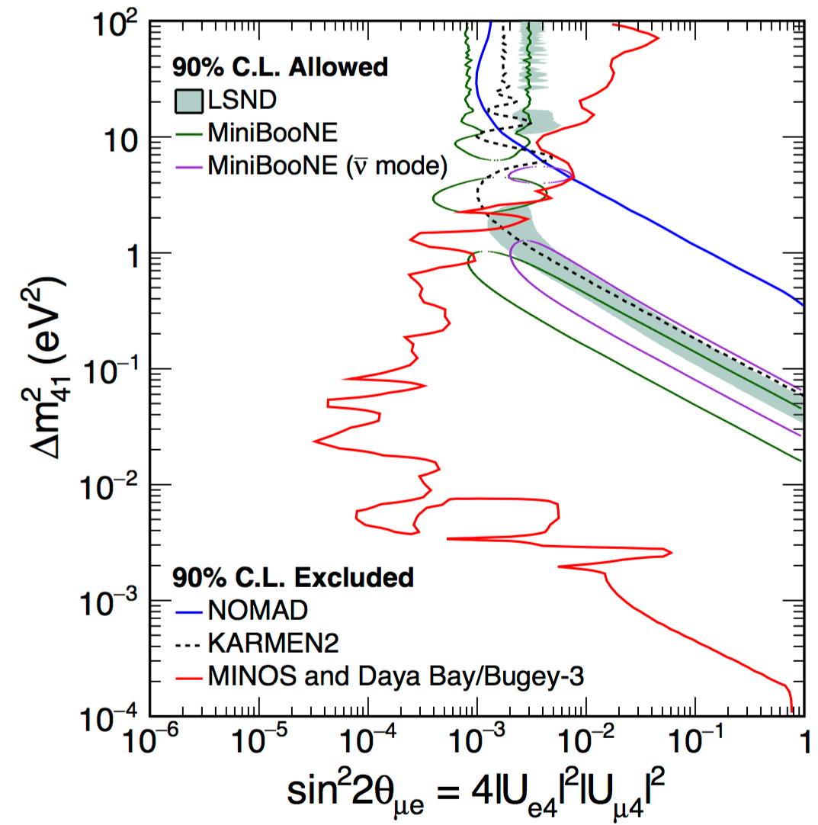
Outline
Daya Bay
Latest Results
Oscillation measurement
Sterile neutrino search
Flux & spectrum measurement of antineutrino
Fuel evolution analysis
Summary

Slide 4
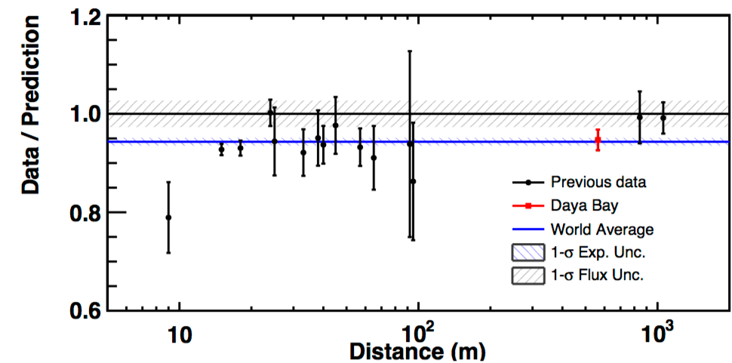
Outline
Daya Bay
Latest Results
Oscillation measurement
Sterile neutrino search
Flux & spectrum measurement of antineutrino
Fuel evolution analysis
Summary

Slide 5
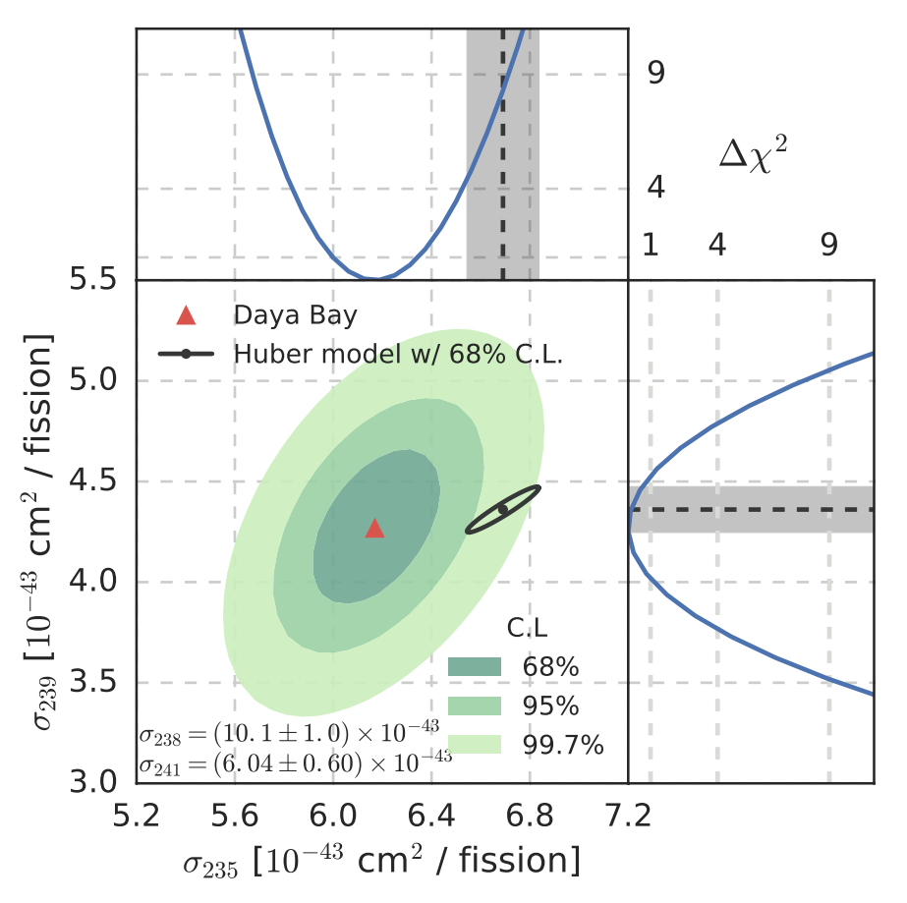
Outline
Daya Bay
Latest Results
Oscillation measurement
Sterile neutrino search
Flux & spectrum measurement of antineutrino
Fuel evolution analysis
Summary

Slide 6
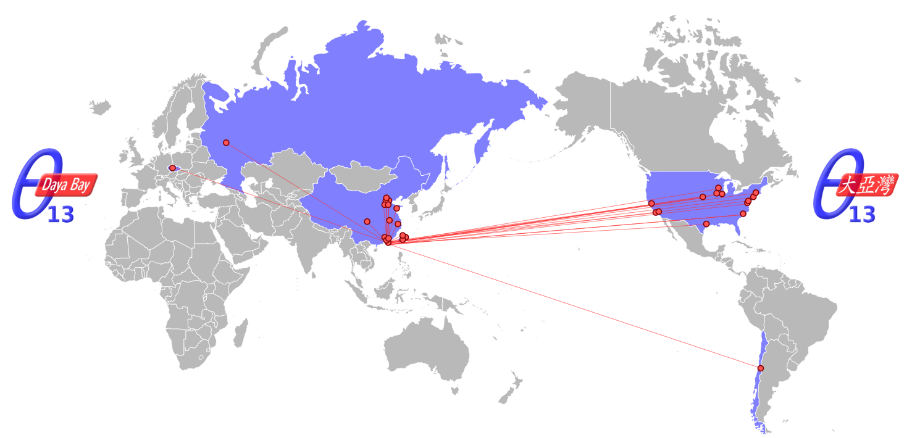
The Daya Bay Collaboration
197 collaborators from 41 institutes
Asia (23)
Beijing Normal Univ., CGNPG, CIAE, Congqing Univ., Dongguan Univ. Tech., ECUST, IHEP, Nanjing Univ., Nankai Univ., NCEPU, NUDT, Shandong Univ., Shanghai Jiao Tong Univ., Shenzhen Univ., Tsinghua Univ., USTC, Xian Jiaotong Univ., Zhongshan Univ.,
Chinese Univ. of Hong Kong, Univ. of Hong Kong,
National Chiao Tung Univ., National Taiwan Univ., National United Univ.
North America (15)
Brookhaven Natl Lab, Illinois Institute of Technology, Iowa State, Lawrence Berkeley Natl Lab, Princeton, Siena College, Temple University, UC Berkeley, UCLA, Univ. of Cincinnati, Univ. of Houston,
UIUC, Univ. of Wisconsin, Virginia Tech, William & Mary, Yale
South America (1)
Catholic University of Chile
Europe (2)
Charles University, JINR Dubna

Slide 7
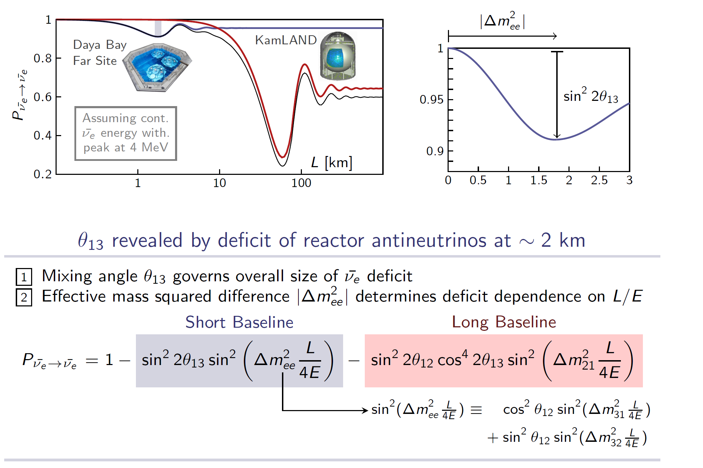
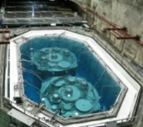
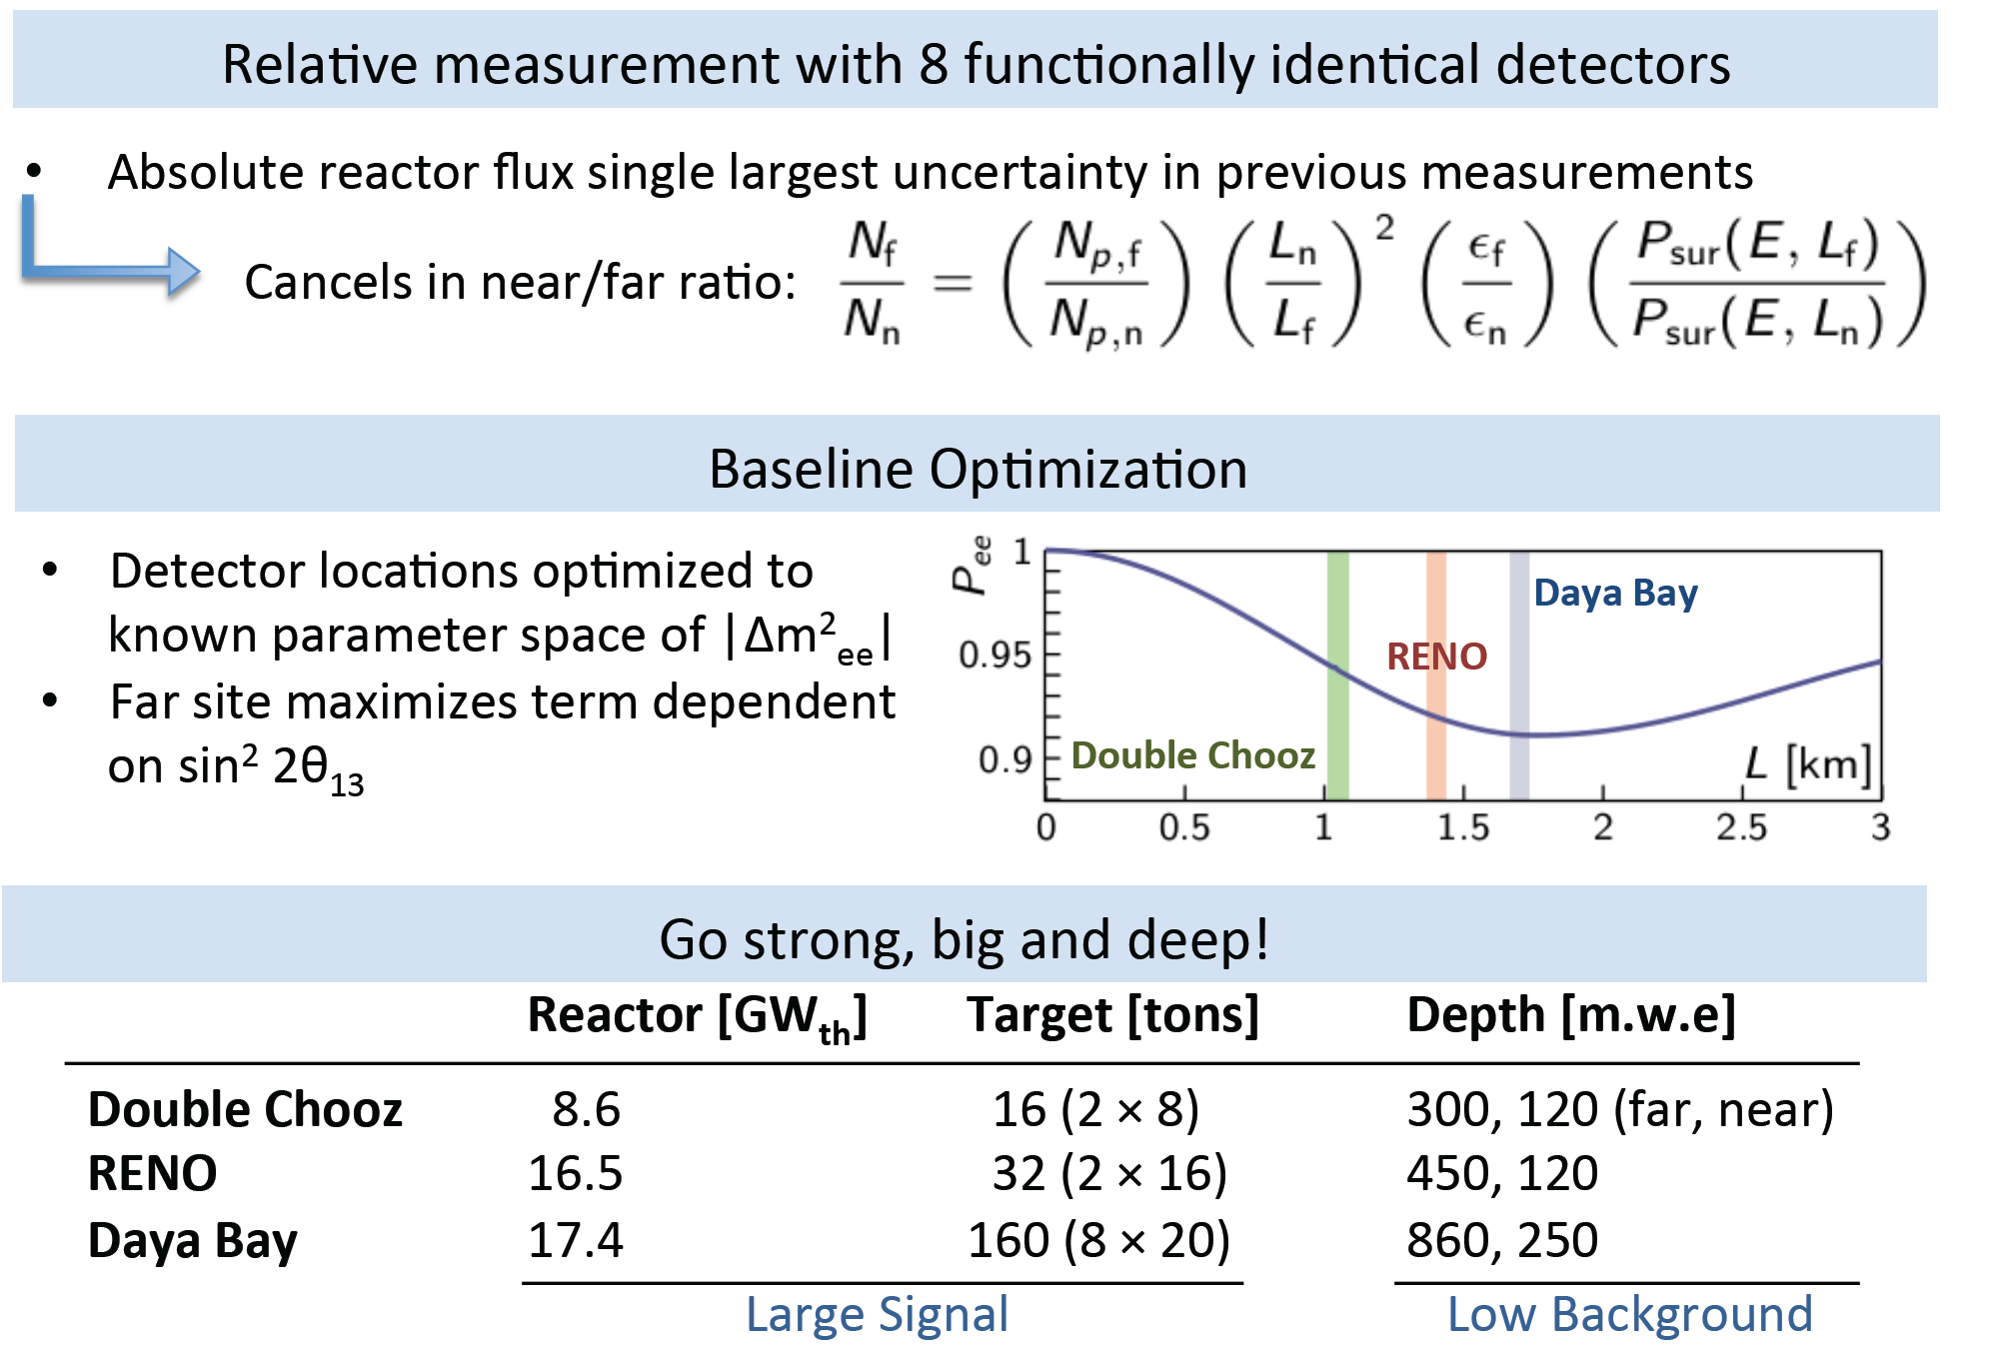
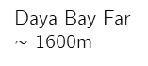
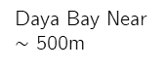
Reactor Neutrino Oscillation
Daya Bay Near
$\sim$ 500m
Daya Bay Far
$\sim$ 1600m

Slide 8
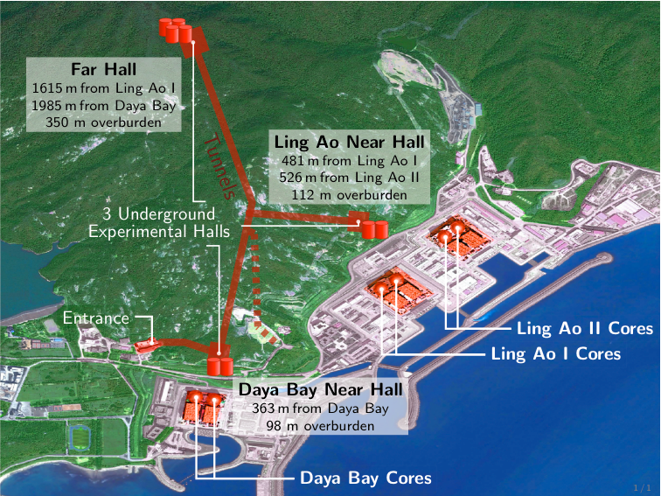
Experimental Setup
8 identically designed detectors close to the Daya Bay Nuclear Power Plant.
Among the most powerful reactor complexes in the world!
(EH3)
Far Hall (EH3)
1540 m from Ling Ao I
1912 m from Daya Bay
860 m.w.e overburden
Ling Ao Near Hall (EH2)
480 m from Ling Ao I
528 m from Ling Ao II
265 m.w.e overburden
Daya Bay Near Hall (EH1)
364 m from Daya Bay
250 m.w.e overburden

Slide 9
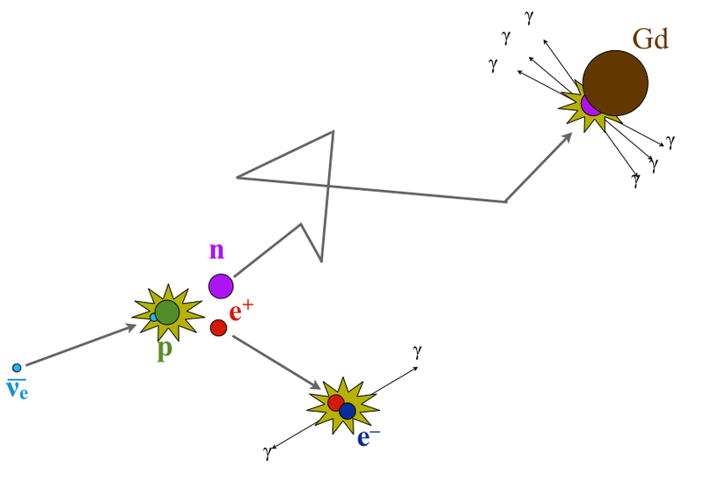
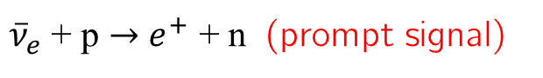
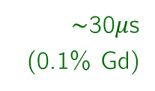
Antineutrino Detection
Inverse β-decay: coincidence of two consecutive signals
${\overline{ν}}_{e}$ + p $→$ $e^{+}$ + n (prompt signal)
$∼$30$μ$s
(0.1% Gd)
+ p $→$ D + γ (2.2 MeV) (delayed signal)
+ Gd $→$ Gd* $→$ Gd + γ’s (8 MeV) (delayed signal)
Powerful background rejection
Positron preserves most information about antineutrino energy

Slide 10
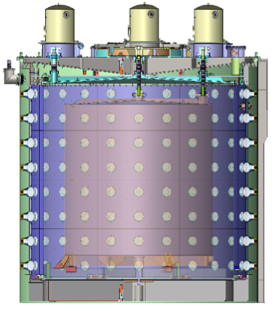
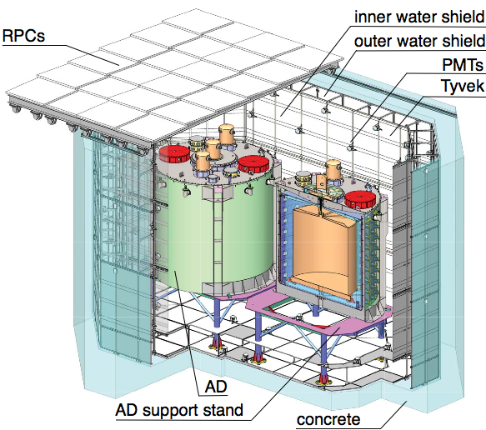
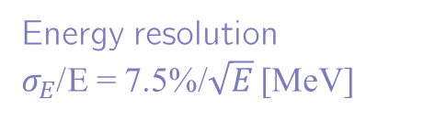
Antineutrino Detectors
Antineutrino detectors (ADs): “three-zone” cylindrical modules immersed in water pools
Gd-doped LS
LS
192 8” PMTs
Mineral Oil
Energy resolution
$σ_{E}$/E = 7.5%/$\sqrt{E}$ [MeV]
Double purpose: shield the ADs and veto cosmic-rays
NIM A 811, 133 (2016)
NIM A 773, 8 (2015)

Slide 11
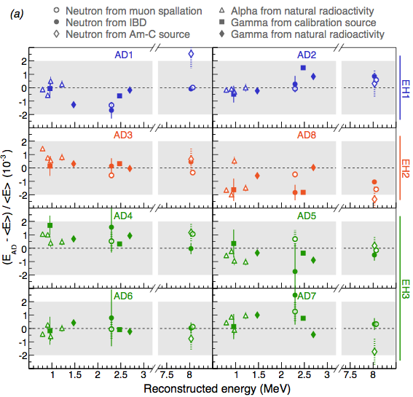
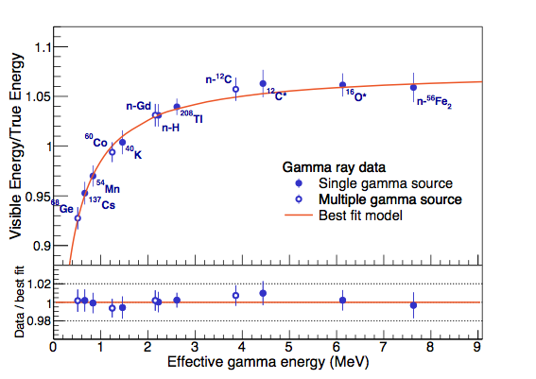

Energy Reconstruction
A variety of natural and artificial sources to perform the relative calibration of the detectors and to construct an energy model
absolute neutrino energy scale uncertainty $\sim$1%
relative energy scale uncertainty < 0.2%

Slide 12
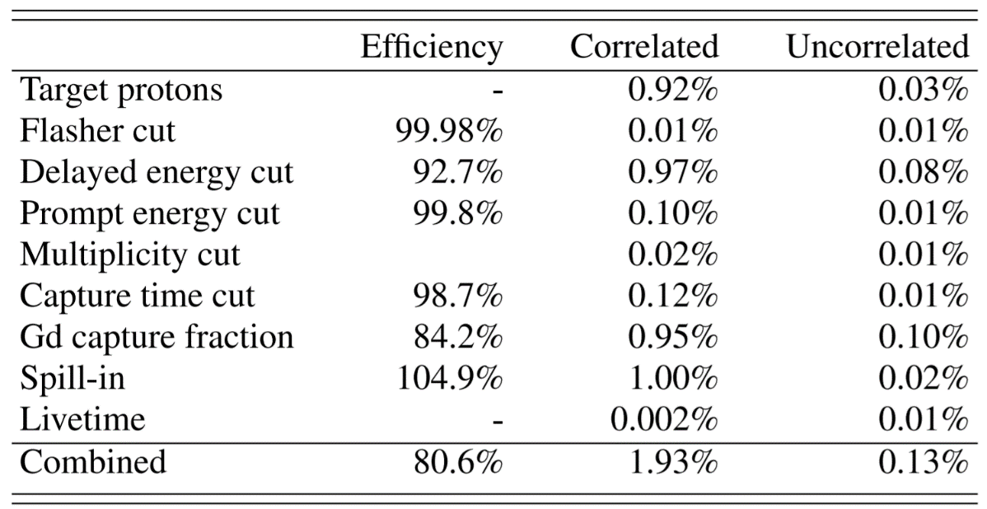
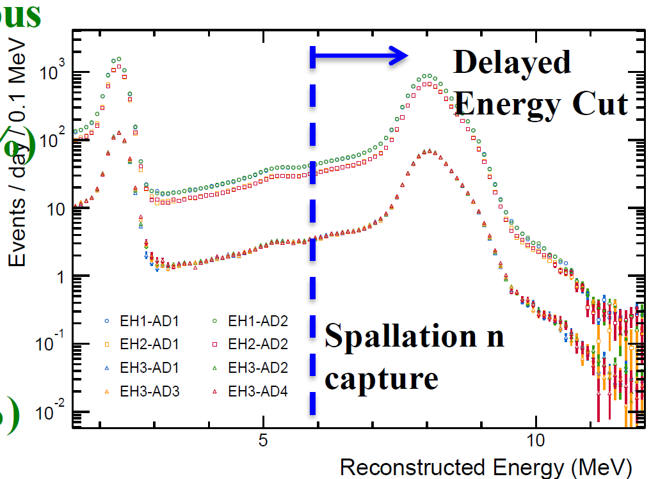
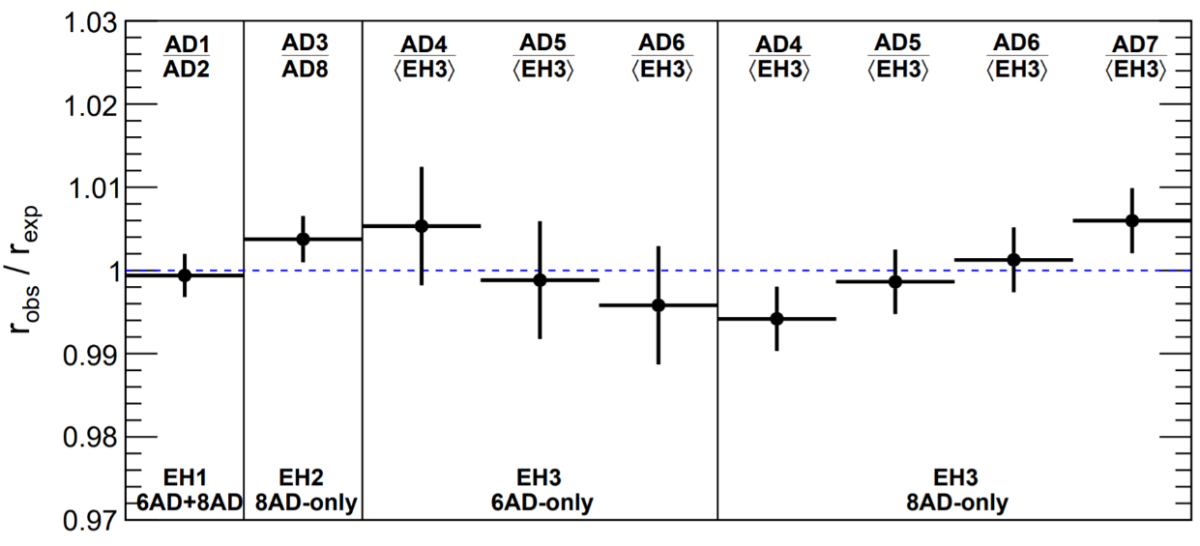
Improvement of Systematics
Detector Efficiency
Previous
0.12%
0.2%
Multiple detectors in the same experimental hall enable the cross-check of the uncorrelated uncertainty

Slide 13
Oscillation Measurement

Slide 14
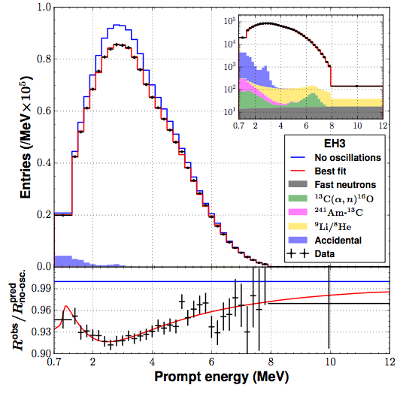
nGd Oscillation Analysis Dataset
Oscillation result based on neutron capture on gadolinium (nGd)
1230 days of data
More than 2.5 million antineutrino interactions (300k in the far hall)
Significant improvements in
background reduction (B/S<2%)
energy calibration

Slide 15
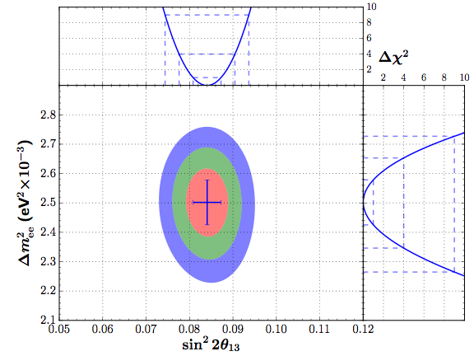
nGd Oscillation Analysis Results
Phys. Rev. D 95, 072006 (2017)
sin²2θ₁₃ = 0.0841 ±0.0027(stat.) ±0.0019(sys.)
|Δm²_{ee}| = [2.50 ±0.06(stat.) ±0.06(sys.)] ×10⁻³eV²
χ²/NDF = 234.7/263
still statistics dominated!

Slide 16
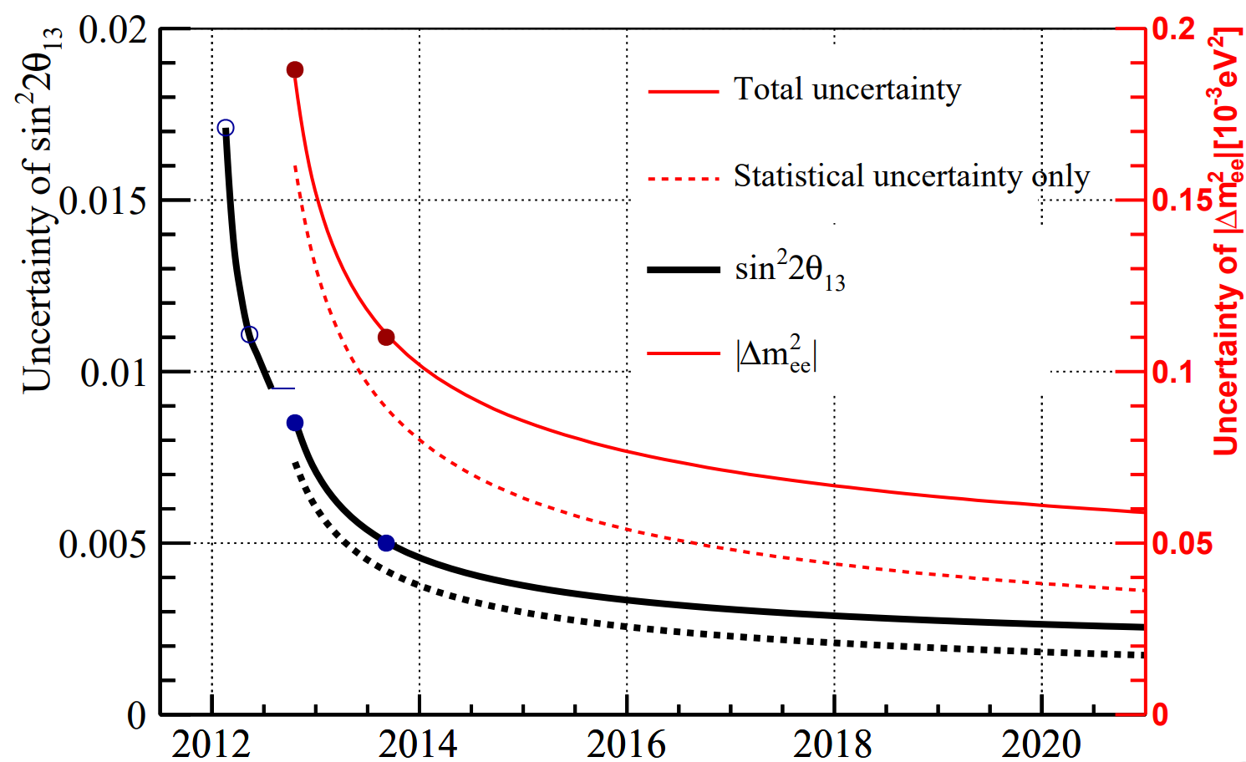
Precision on Oscillation Parameter
Plan to run till 2020: uncertainties of sin²2θ₁₃ and |Δm²_{ee}| below 3%

Slide 17
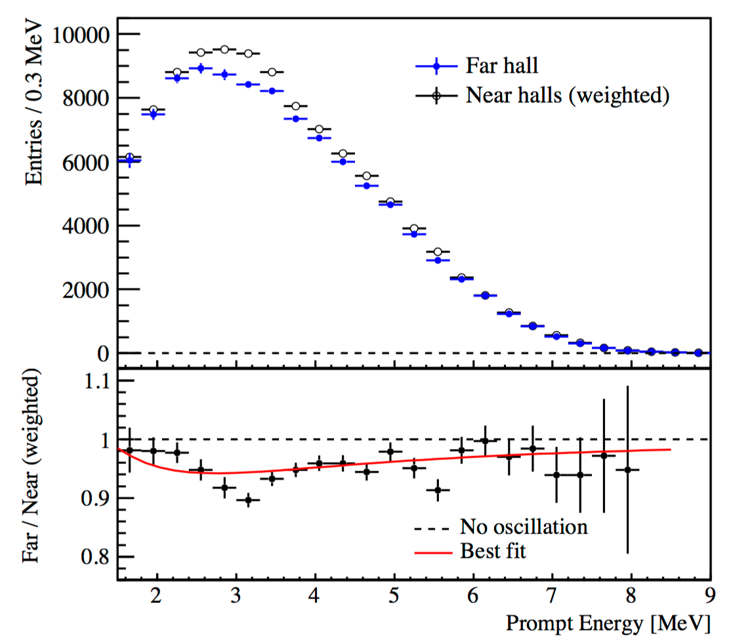
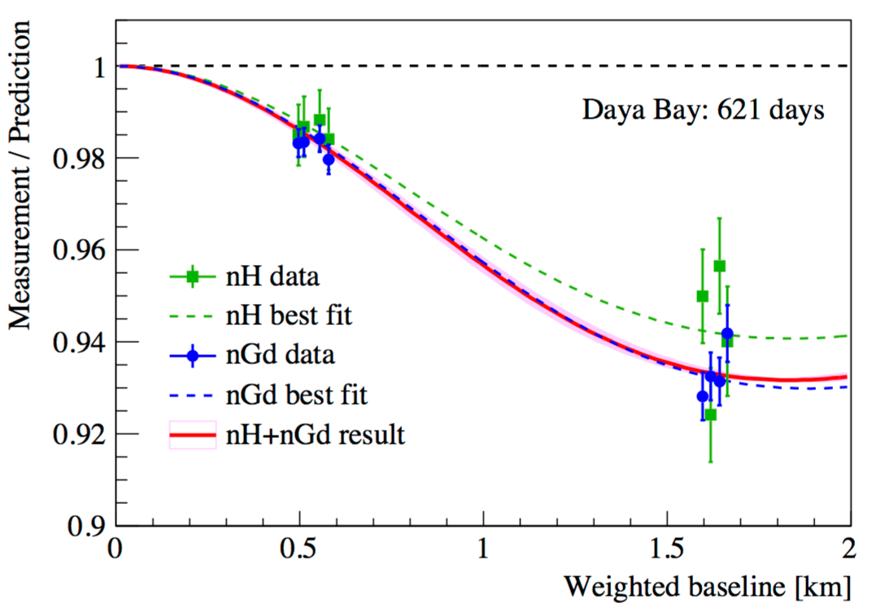
nH Oscillation Analysis Results
Phys. Rev. D 93, 072011 (2016)
An independent measurement is achieved with IBD events where the neutron captures on hydrogen
Independent with nGd analysis in detector related systematics
Common in reactor related systematics
One of the challenges is the large accidental background (>50 times larger than for nGd analysis)
sin²2θ₁₃ = 0.071±0.11, χ²/NDF= 6.3/6

Slide 18
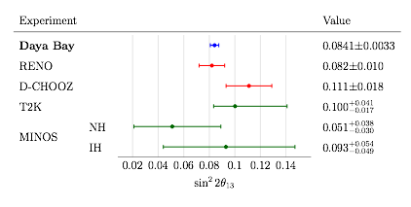
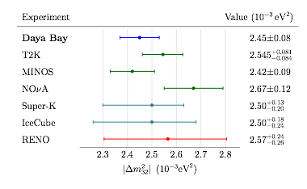
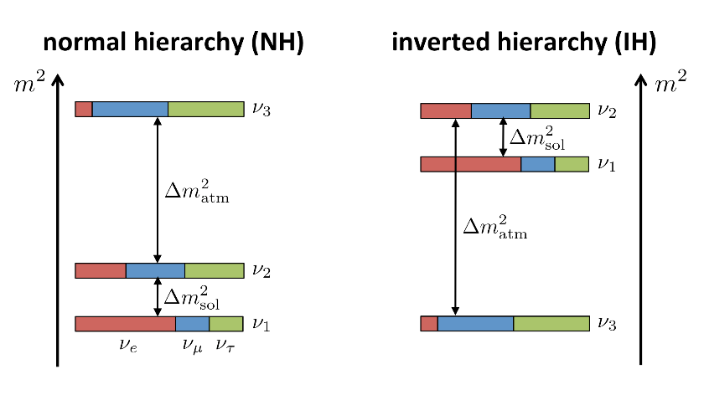
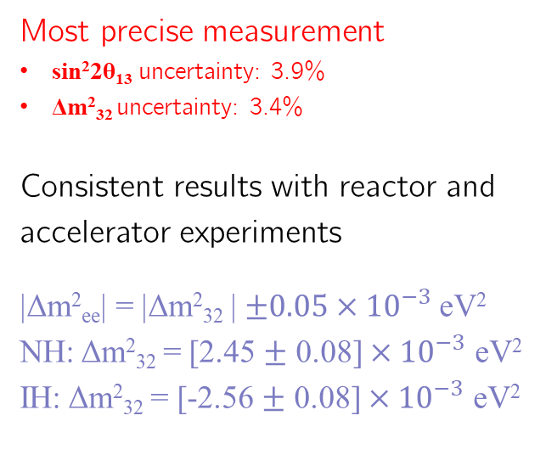
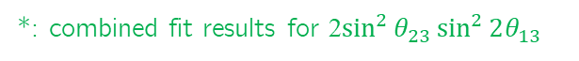
Global Comparison
Most precise measurement
sin²2θ₁₃ uncertainty: 3.9%
Δm²₃₂ uncertainty: 3.4%
Consistent results with reactor and accelerator experiments
|Δm²_{ee}| = |Δm²₃₂ |$±0.05×{10}^{−3}$ eV²
NH: Δm²₃₂ = [2.45 $±$ 0.08] $×{10}^{−3}$ eV²
IH: Δm²₃₂ = [-2.56 $±$ 0.08] $×{10}^{−3}$ eV²
1230 days
Daya Bay (nH)
0.071± 0.11
*
NH
*: combined fit results for 2$\sin^{2}{θ_{23}}\sin^{2}{2θ_{13}}$

Slide 19
Sterile Neutrino Search

Slide 20
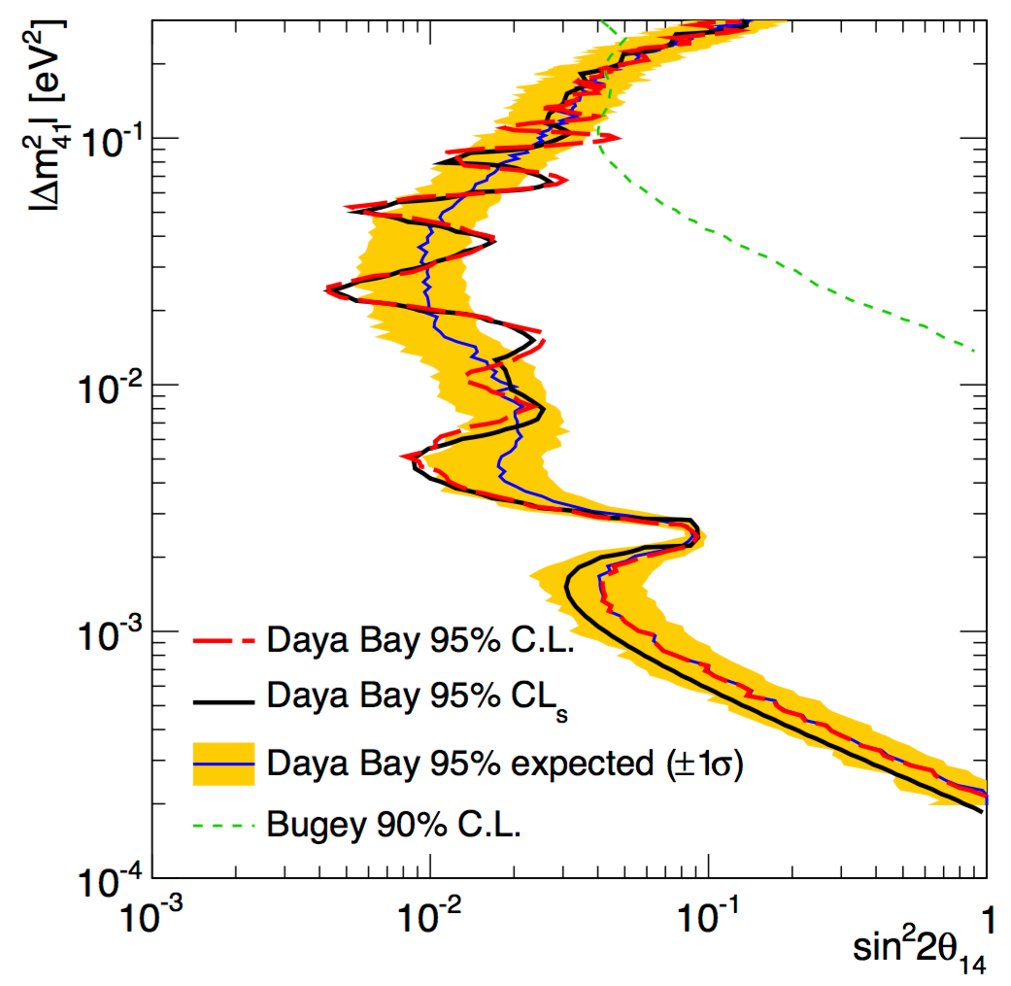
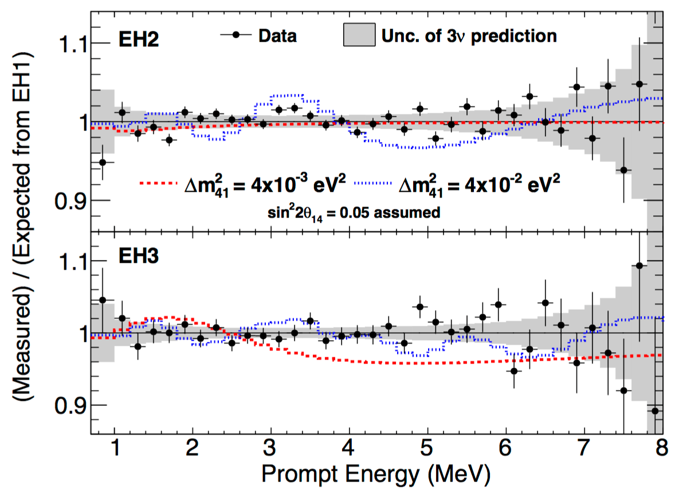
Search for Light Sterile Neutrino
Phys. Rev. Lett. 117 (2016) no.15, 151802
A relative comparison of the energy spectra at the three sites allows to search for sterile neutrino mixing
Signal would primarily appear as an additional spectral distortion with a frequency different from standard 3ν oscillations
The most stringent limits on sin²2θ₁₄ in the 2×10⁻⁴ eV² < Δm²₄₁ < 0.2 eV² region

Slide 21

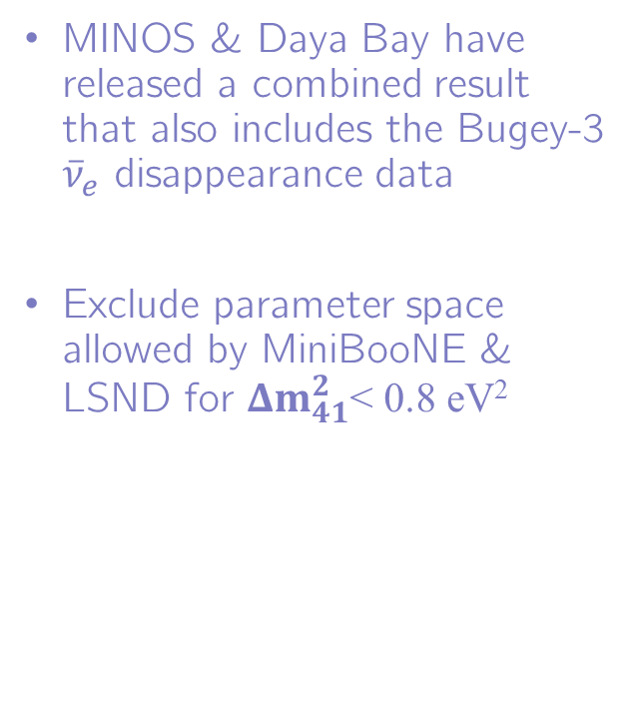

Constraining Appearance Results
Phys. Rev. Lett. 117 (2016) no.15, 151801
Addendum: Phys. Rev. Lett. 117 (2016) no.20, 209901
MINOS & Daya Bay have released a combined result that also includes the Bugey-3 ${\overline{ν}}_{e}$ disappearance data
Exclude parameter space allowed by MiniBooNE & LSND for $Δm_{41}^{2}$< 0.8 eV²
constrained with ${\overline{ν}}_{e}$ disapperance
constrained with $ν_{μ}$ disappearance

Slide 22
Antineutrino Flux & Spectrum

Slide 23
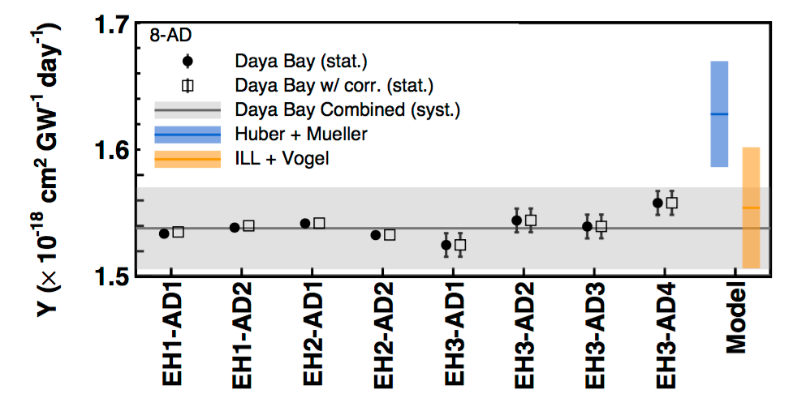
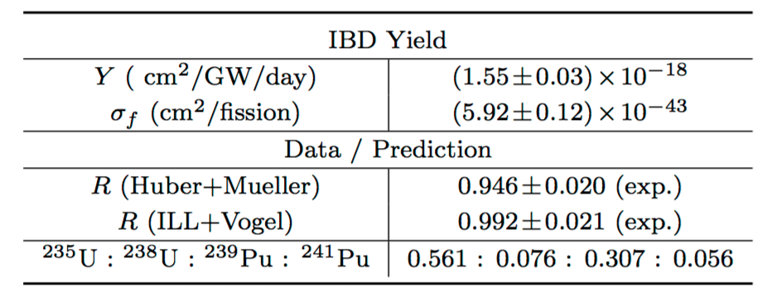
Reactor Antineutrino Flux
Chin. Phys. C 41(1) (2017)
621 days of data
Measurement of IBD yield in the eight detectors is consistent with other experiments measurement
“Reactor Antineutrino Anomaly”
R_{global} = 0.942 ± 0.009(exp) ± 0.023(model)
R_{global+DYB} = 0.943 ± 0.008(exp) ± 0.023(model)
Discrepancy with Huber+Mueller (HM) model could be due to underestimated uncertainties in the prediction, and/or the existence of a sterile neutrino.

Slide 24
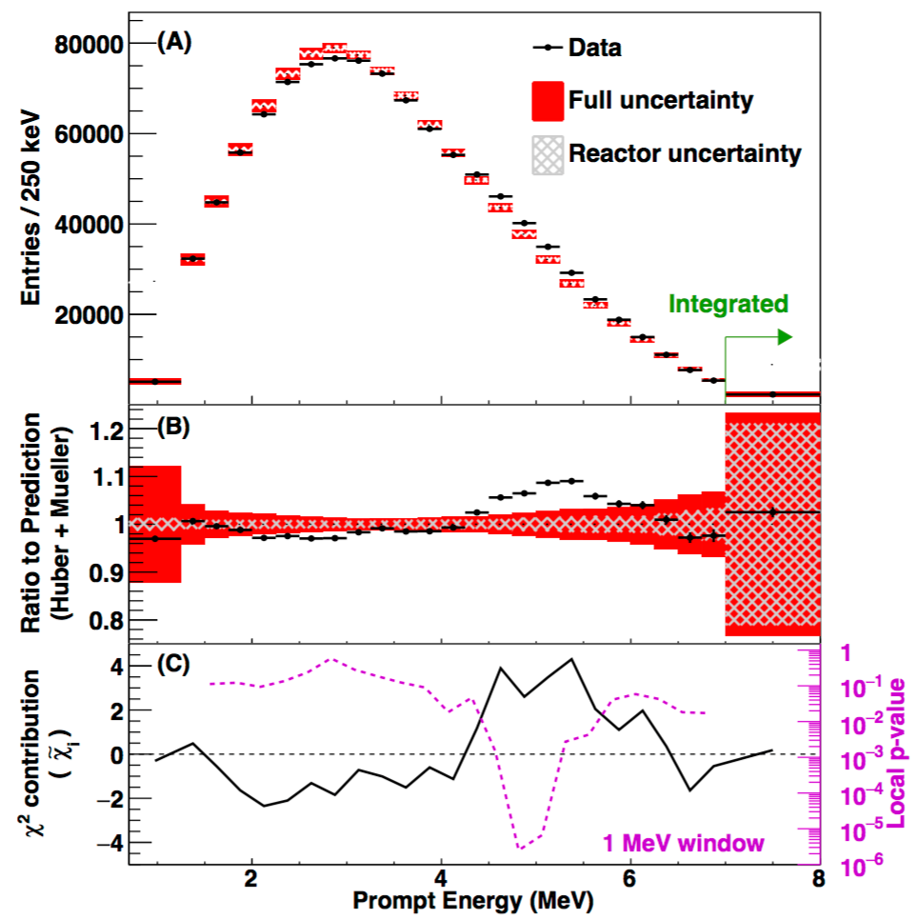
Reactor Antineutrino Spectrum
Chin. Phys. C 41(1) (2017)
High-statistics measurement of the spectral shape of reactor antineutrinos
Global discrepancy with the Huber+Mueller prediction at 2.9𝜎 (4.4𝜎 in the 4-6 MeV region)
Excess events have all the IBD characteristics and are
correlated with reactor power
time independent
Excess does not appear in ¹²B spectra (disfavoring detector effects), and cannot be reproduced by a single β-decay branch or mono-energetic line

Slide 25
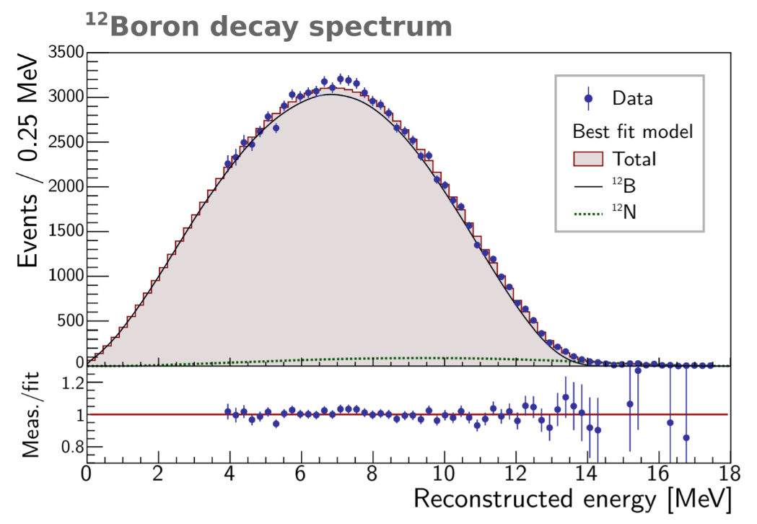
Reactor Antineutrino Spectrum
Chin. Phys. C 41(1) (2017)
High-statistics measurement of the spectral shape of reactor antineutrinos
Global discrepancy with the Huber+Mueller prediction at 2.9𝜎 (4.4𝜎 in the 4-6 MeV region)
Excess events have all the IBD characteristics and are
correlated with reactor power
time independent
Excess does not appear in ¹²B spectra (disfavoring detector effects), and cannot be reproduced by a single β-decay branch or mono-energetic line

Slide 26
Fuel Evolution Analysis

Slide 27
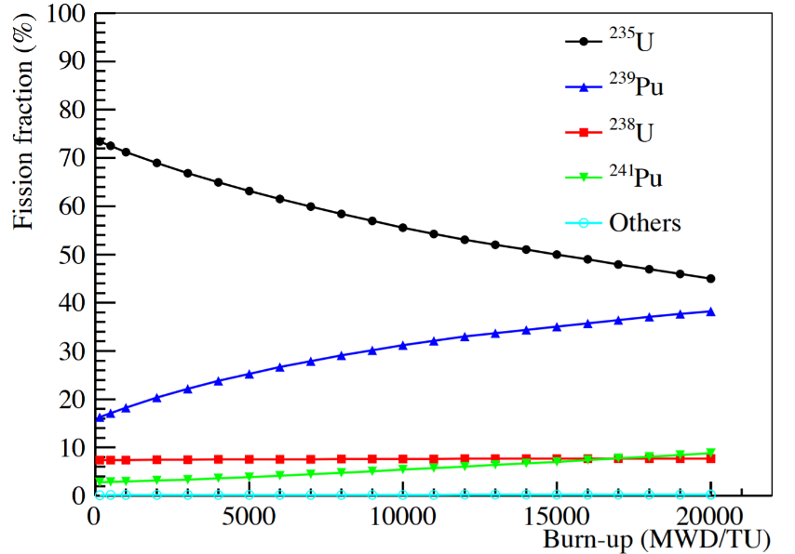
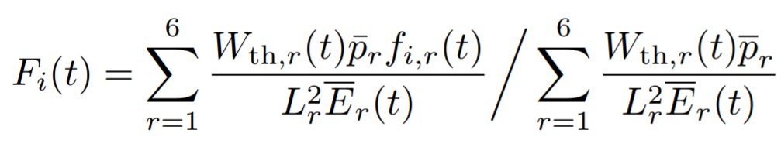
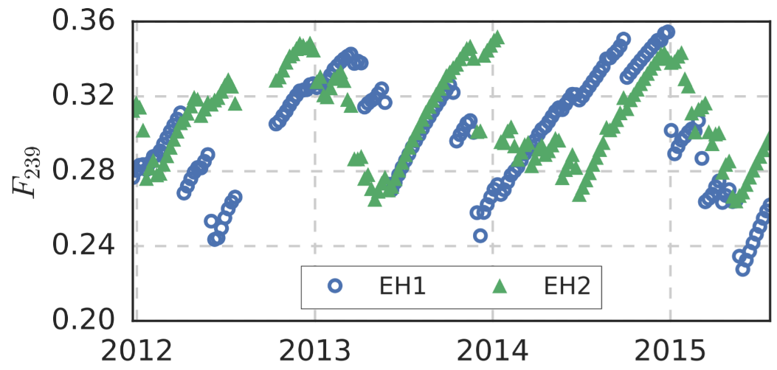
Fission Fraction in Daya Bay
Fission fraction changes in a burn-up cycle for
²³⁵U, ²³⁹Pu, ²³⁸U, ²⁴¹Pu
Effective fission fraction: Weight each reactor’s fission fraction by distance, power and oscillation
Can Daya Bay detectors measure the variation in antineutrino flux for different fission fraction?
weight; then repeat x6

Slide 28
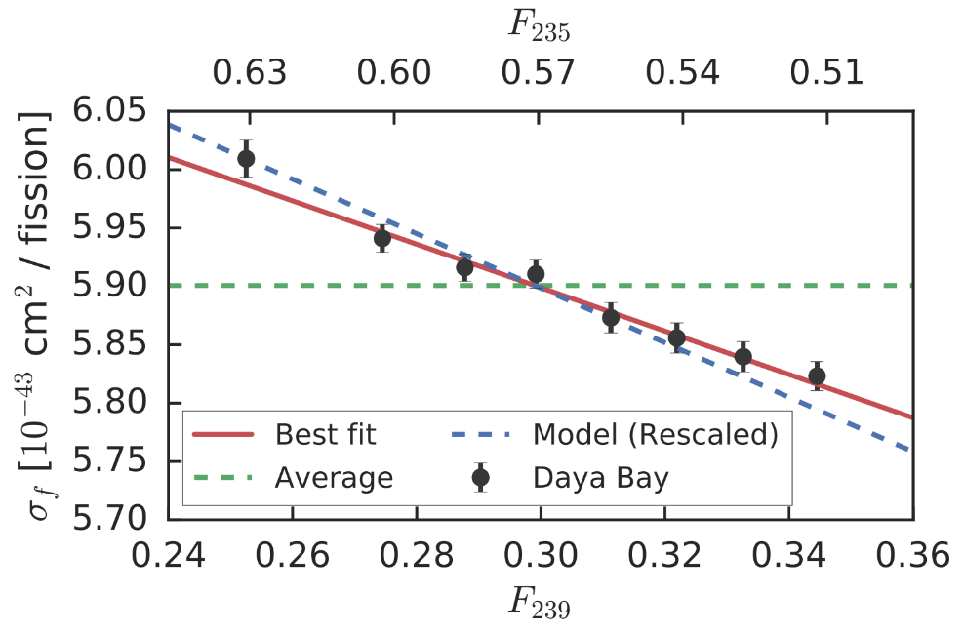
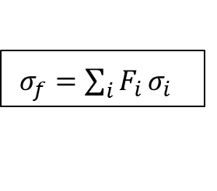
Antineutrino Flux Evolution
Phys. Rev. Lett. 118, 251801
Flux evolution: IBD yield per fission changes with fission fraction of ²³⁹Pu, as well as ²³⁵U
7.8%
$σ_{f}=\sum_{i}{F_{i}}σ_{i}$
Data imply a 7.8% overestimation of IBD yield from ²³⁵U in Huber model
²³⁵U could be the primary contributor to the “reactor antineutrino anomaly”
Flux evolution shows some tension with the Huber+Mueller model

Slide 29
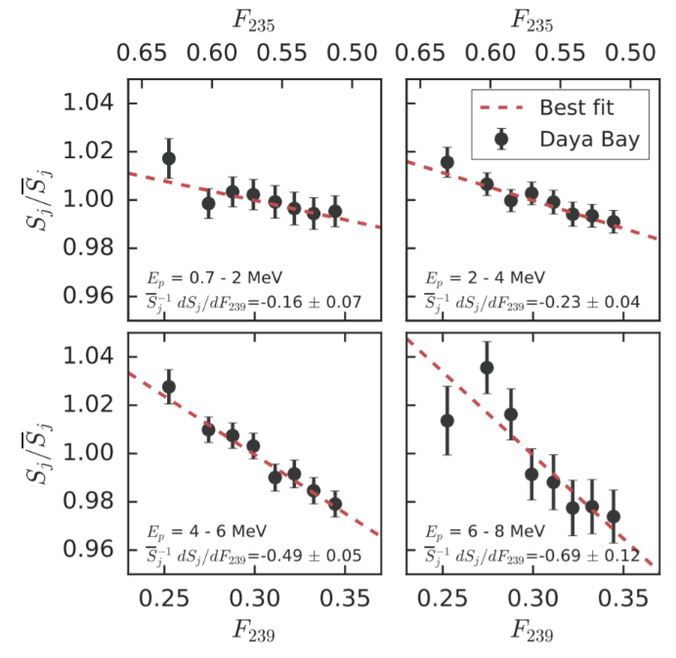
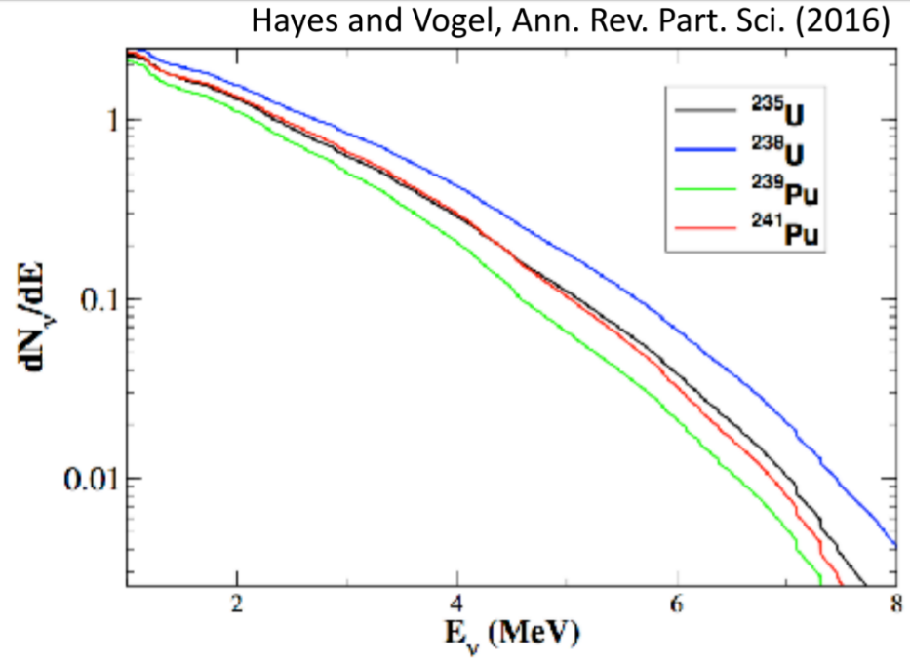
Evolution in Energy Spectrum
The energy spectrum difference between ²³⁵U and ²³⁹Pu is also observed in the evolution.
First time this is unambiguously measured
Most models do predict this, however.
The slopes for flux evolution are different in different energy slides

Slide 30
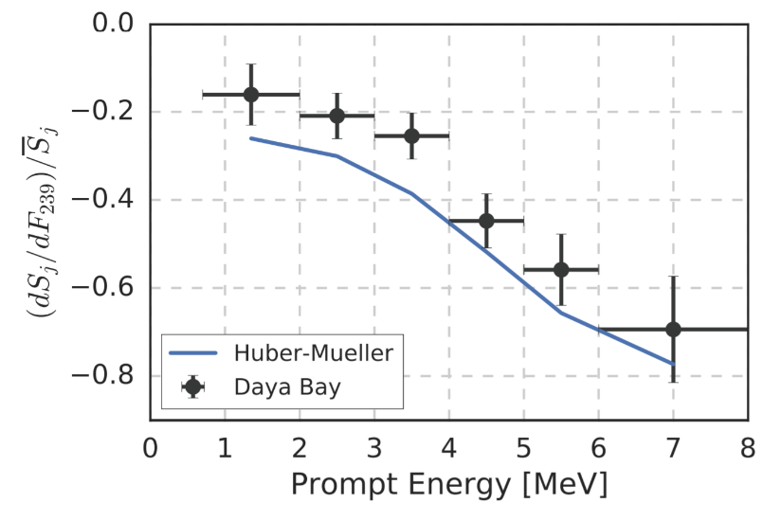
Spectrum Evolution: Data-Model Comparison
4-6 MeV region: no strange behavior visible compared with HM models
No major indication that ‘bump’ comes from a particular isotopes
Highly-enriched U reactors is helpful to probe the ²³⁵U over-prediction and the isotope origin of the ‘bump’
slope

Slide 31
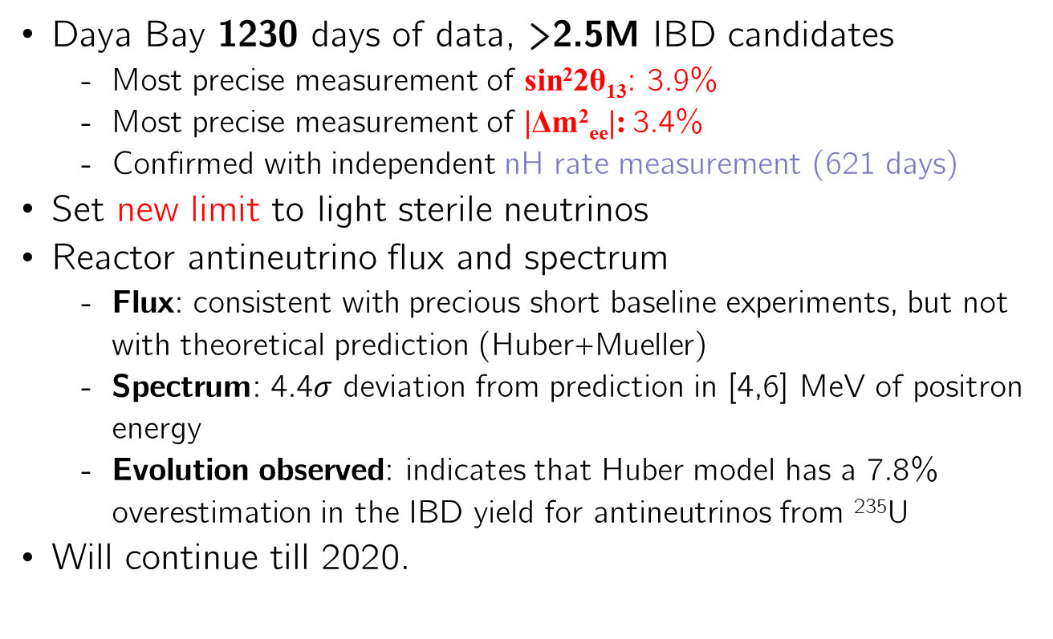
Summary
Daya Bay 1230 days of data, >2.5M IBD candidates
Most precise measurement of sin²2θ₁₃: 3.9%
Most precise measurement of |Δm²_{ee}|: 3.4%
Confirmed with independent nH rate measurement (621 days)
Set new limit to light sterile neutrinos
Reactor antineutrino flux and spectrum
Flux: consistent with precious short baseline experiments, but not with theoretical prediction (Huber+Mueller)
Spectrum: 4.4$σ$ deviation from prediction in [4,6] MeV of positron energy
Evolution observed: indicates that Huber model has a 7.8% overestimation in the IBD yield for antineutrinos from ²³⁵U
Will continue till 2020.

Slide 32
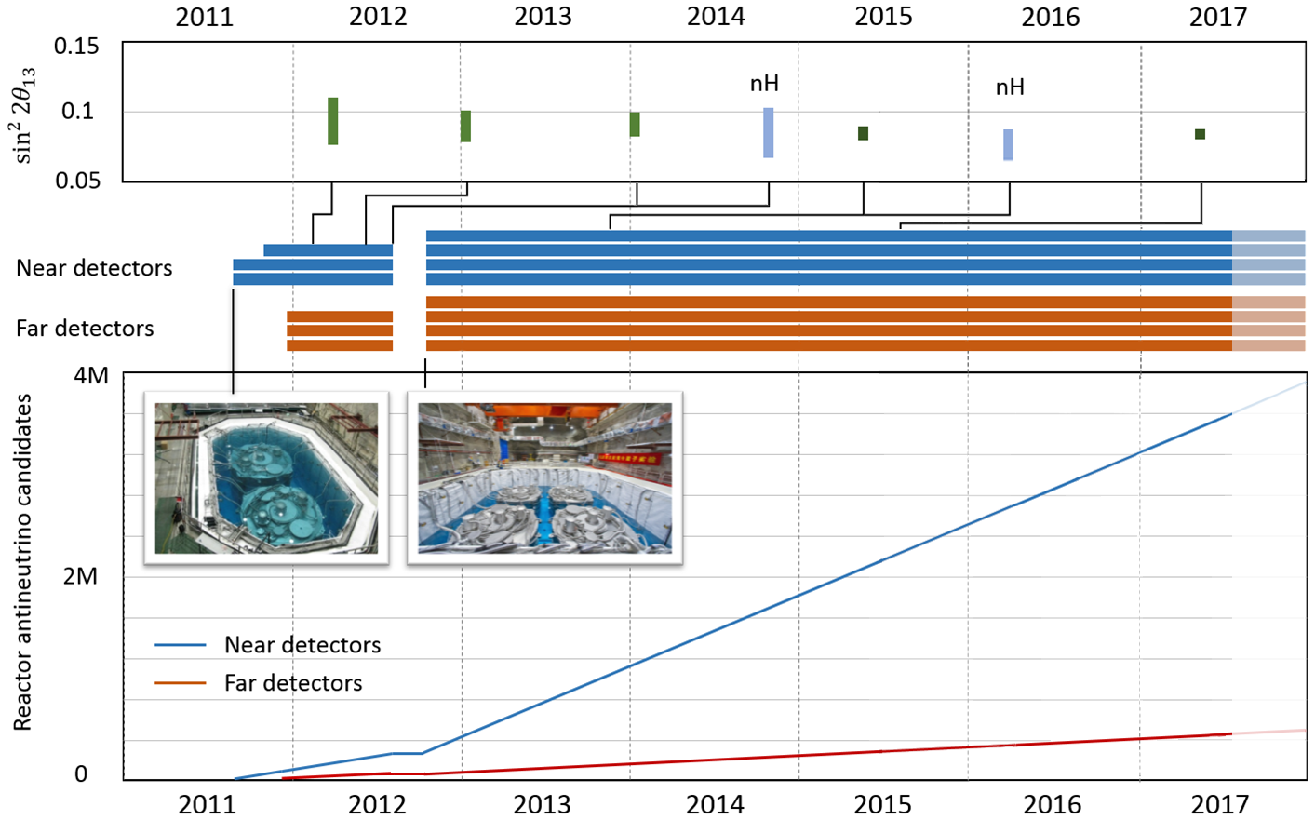
Data Collection
217 days
404 days
609 days

Slide 33

Daya Bay Timeline
 | Physics analysis published date | Detector status
2011 | AD 1/2 comparison | 2 EH1 ADs start data taking in Aug. 2+1+3 ADs start data taking in Dec.
2012 | March, First 5$σ$ $θ_{13}$, rate only, 55d | Calibration campaign in Jun. 2+2+4 ADs start data taking in Oct.
2013 | Improved $θ_{13}$ (9$σ$), rate only, 139d
2014 | Spectral analysis ($θ_{13}$ and $Δm^{2}$), 217d nH rate analysis, 217d Sterile neutrino, 217d
2015 | Full 8AD oscillation analysis, 621d | AD1 Flash-ADC upgrade in Dec.
2016 | Reactor flux & spectrum, 217d Improved nH, 621d Improved sterile nu, 621d Combined sterile with MINOS, 621d
2017 | Long reactor paper, 621d Long osc. Paper, 1230d Fuel evolution, 1230d | Calibration campaign in Jan. AD1 taken out for LS study in Jan.

